Slide 1
Predicting Shooting Incident Fatalities: NYPD Data Analysis
Using Machine Learning to Support Law Enforcement Strategies
Ridhin Rajesh

Slide 2
Introduction and Objectives
Problem:
Shooting incidents in NYC pose a public safety challenge, with varying fatality rates.
Goal:
Develop a machine learning model to classify incidents as fatal or non-fatal and identify risk factors.
Objectives:
Build a predictive model.
Uncover temporal, spatial, and demographic patterns.
Provide actionable recommendations for law enforcement.

Slide 3
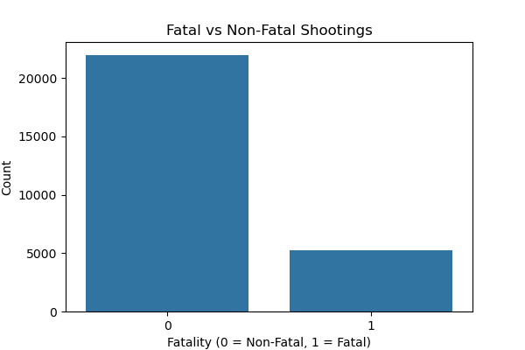
Data Overview
Source: NYPD Shooting Incident Data (Historic).
Key Features:
Temporal: Date, time (year, month, day, hour).
Spatial: Borough, precinct, jurisdiction, location type.
Demographic: Victim/perpetrator age, sex, race.
Target: STATISTICAL_MURDER_FLAG (0 = non-fatal, 1 = fatal).
Size: ~24,000 incidents after preprocessing.
Challenge: Class imbalance (~16% fatal).

Slide 4
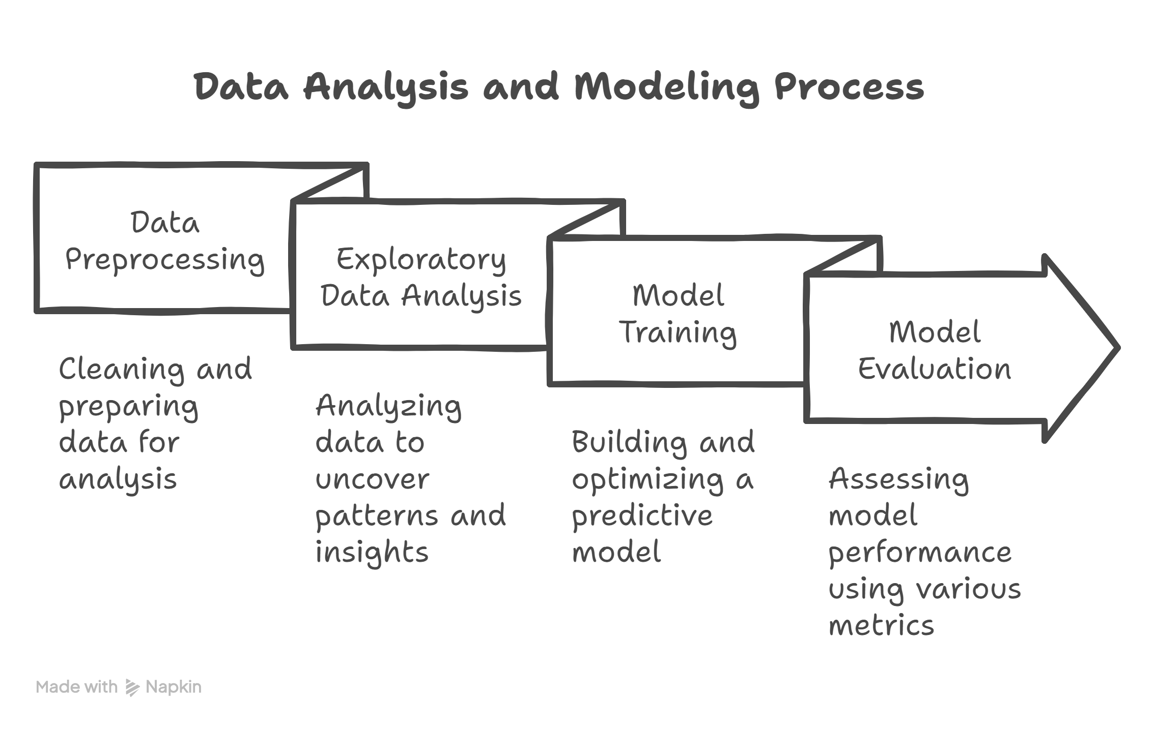
Methodology
Preprocessing:
Dropped irrelevant columns, engineered cyclical temporal features.
Imputed missing ages, cleaned invalid entries, label-encoded categories.
EDA:
Analyzed temporal trends, spatial hotspots, demographic patterns, and interactions.
Modeling:
Random Forest Classifier with SMOTE for imbalance.
Grid search optimized for F1-score.
Evaluation:
Precision, recall, F1-score, ROC AUC, precision-recall curve.

Slide 5
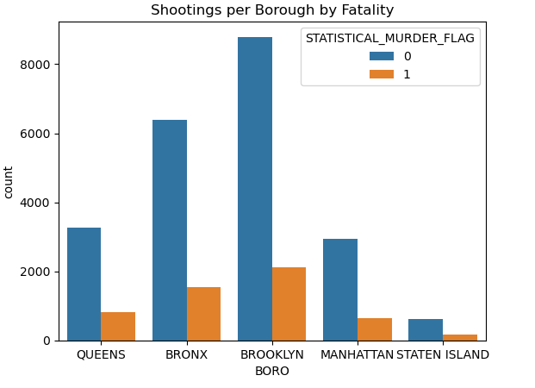
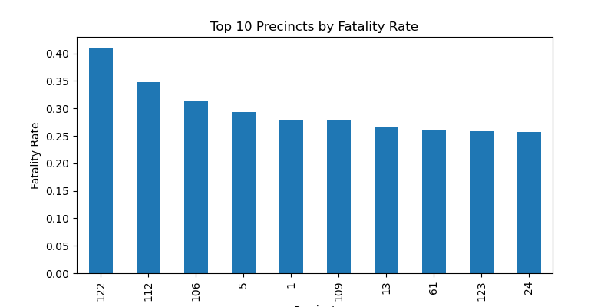
EDA – Spatial Insights
Boroughs: Brooklyn has the highest shooting count (~8,000), with ~2,000 fatal.
Precincts: Top hotspots include precincts 47, 73.
Jurisdiction: Housing areas have higher fatality rates.

Slide 6
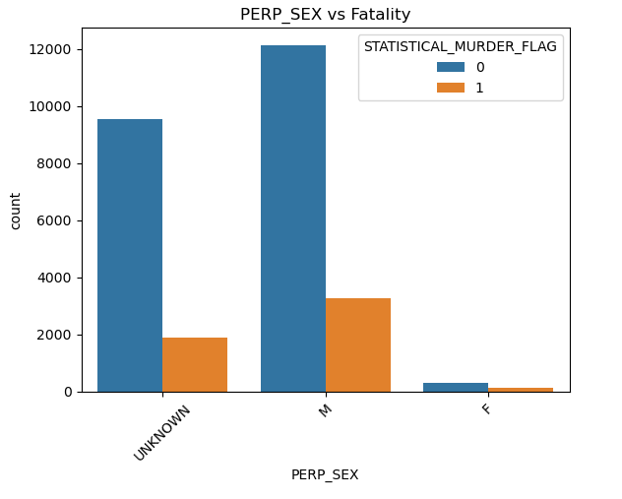
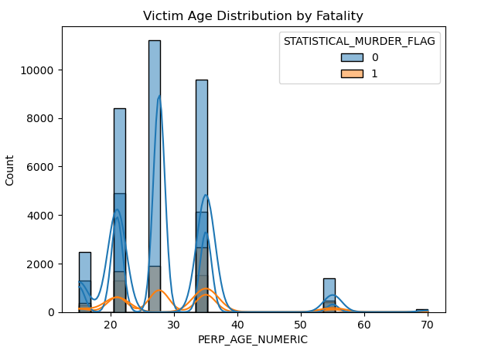
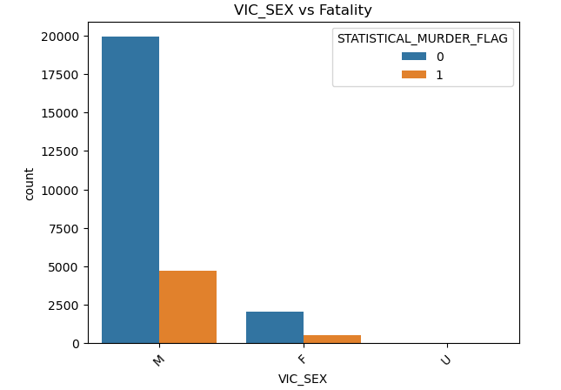
EDA – Demographic and Location Insights
Victim Age: 18–44-year-olds face highest risks (~25%).
Perpetrator Sex: Male perpetrators dominate (~12,000 incidents, ~4,000 fatal).
Victim Sex: Male victims are most common (~17,500 incidents, ~5,000 fatal).

Slide 7
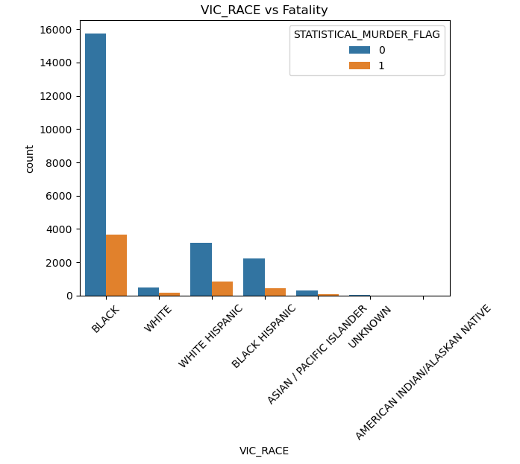
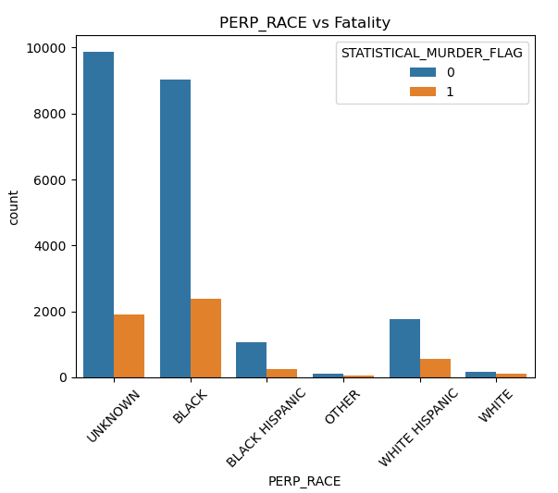
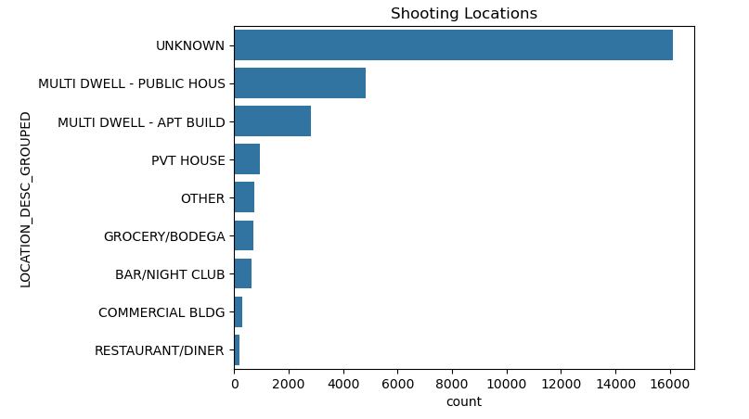
Victim Race: Black victims have the highest count (~14,000, ~4,000 fatal).
Perpetrator Race: Unknown and Black perpetrators are most frequent.
Location Type: Apartments have ~20% fatality rate.

Slide 8
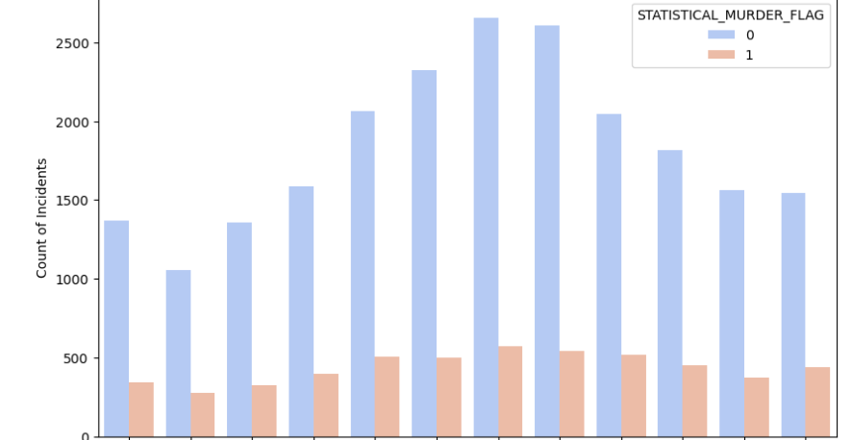
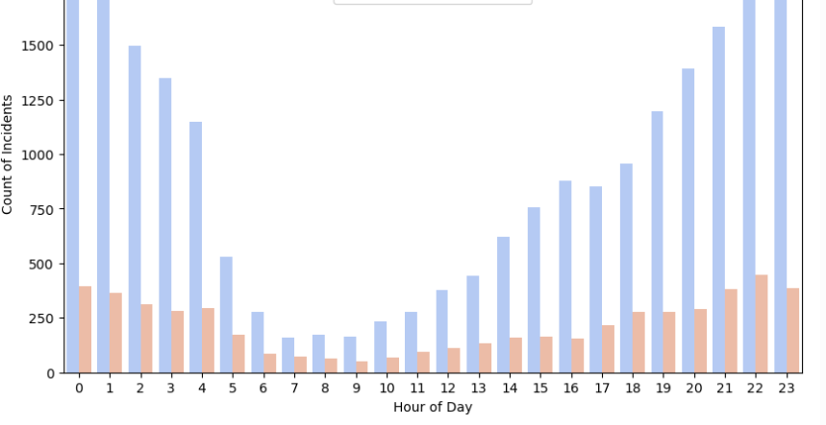
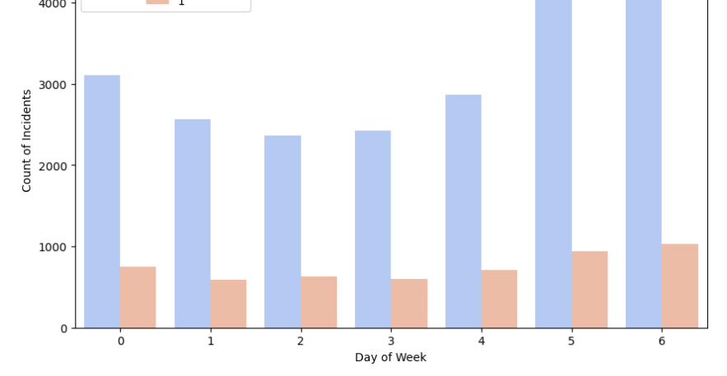
Yearly Trends: Fatality rates vary, with peaks in certain years.
Hourly Patterns: Highest incident counts and fatalities occur at 0–2 AM and 20–23 PM (~1,750 incidents, ~500 fatal).
Day of Week: Friday–Sunday (days 4–6) show the highest counts (~4,000–4,500 incidents, ~1,000 fatal).
Monthly Patterns: June–August (months 6–8) have the highest counts (~2,500 incidents, ~500–600 fatal).

Slide 9
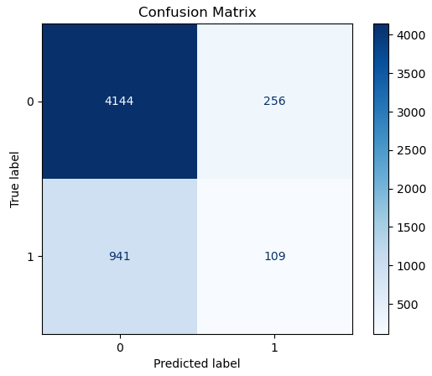
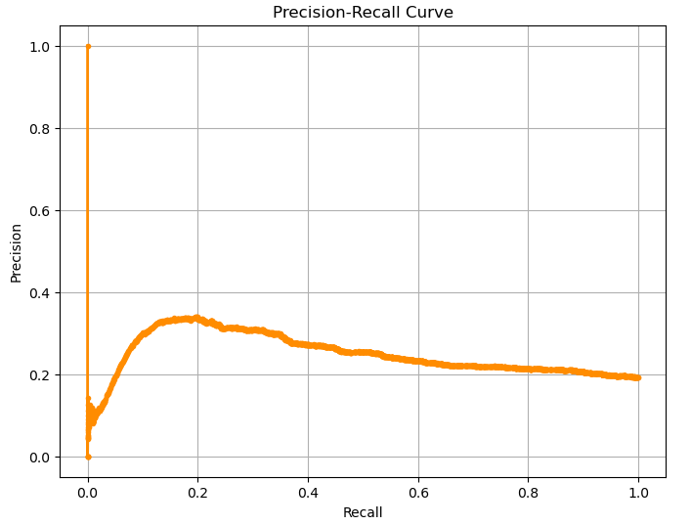
Model Performance
Algorithm: Random Forest Classifier (with SMOTE)
Metrics:
Accuracy: 77%
Non-Fatal (Class 0): Precision = 81%, Recall = 93%, F1-score = 87%
Fatal (Class 1): Precision = 25%, Recall = 9%, F1-score = 13%
ROC AUC Score: 0.58
Key Insight: The model shows strong performance for non-fatal incidents, but struggles with identifying fatal cases. Despite applying SMOTE, recall for fatalities remains low, indicating further balancing or model tuning is needed for better fatality prediction.

Slide 10
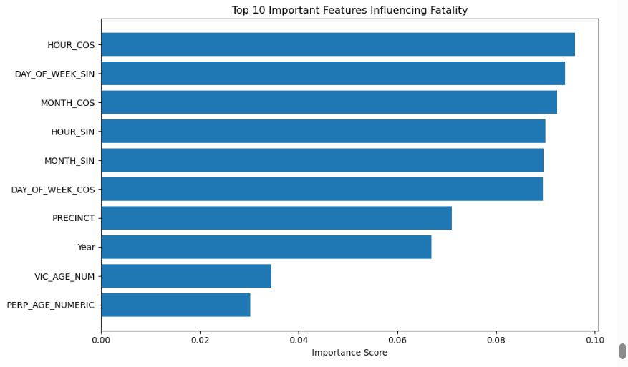
Key Predictors
Top Features:
Time of day (HOUR_SIN, HOUR_COS): 29% of importance.
Location (PRECINCT, BORO): 23%.
Victim age (VIC_AGE_NUM): 10%.
Implication: Temporal and spatial factors drive fatality risk.

Slide 11
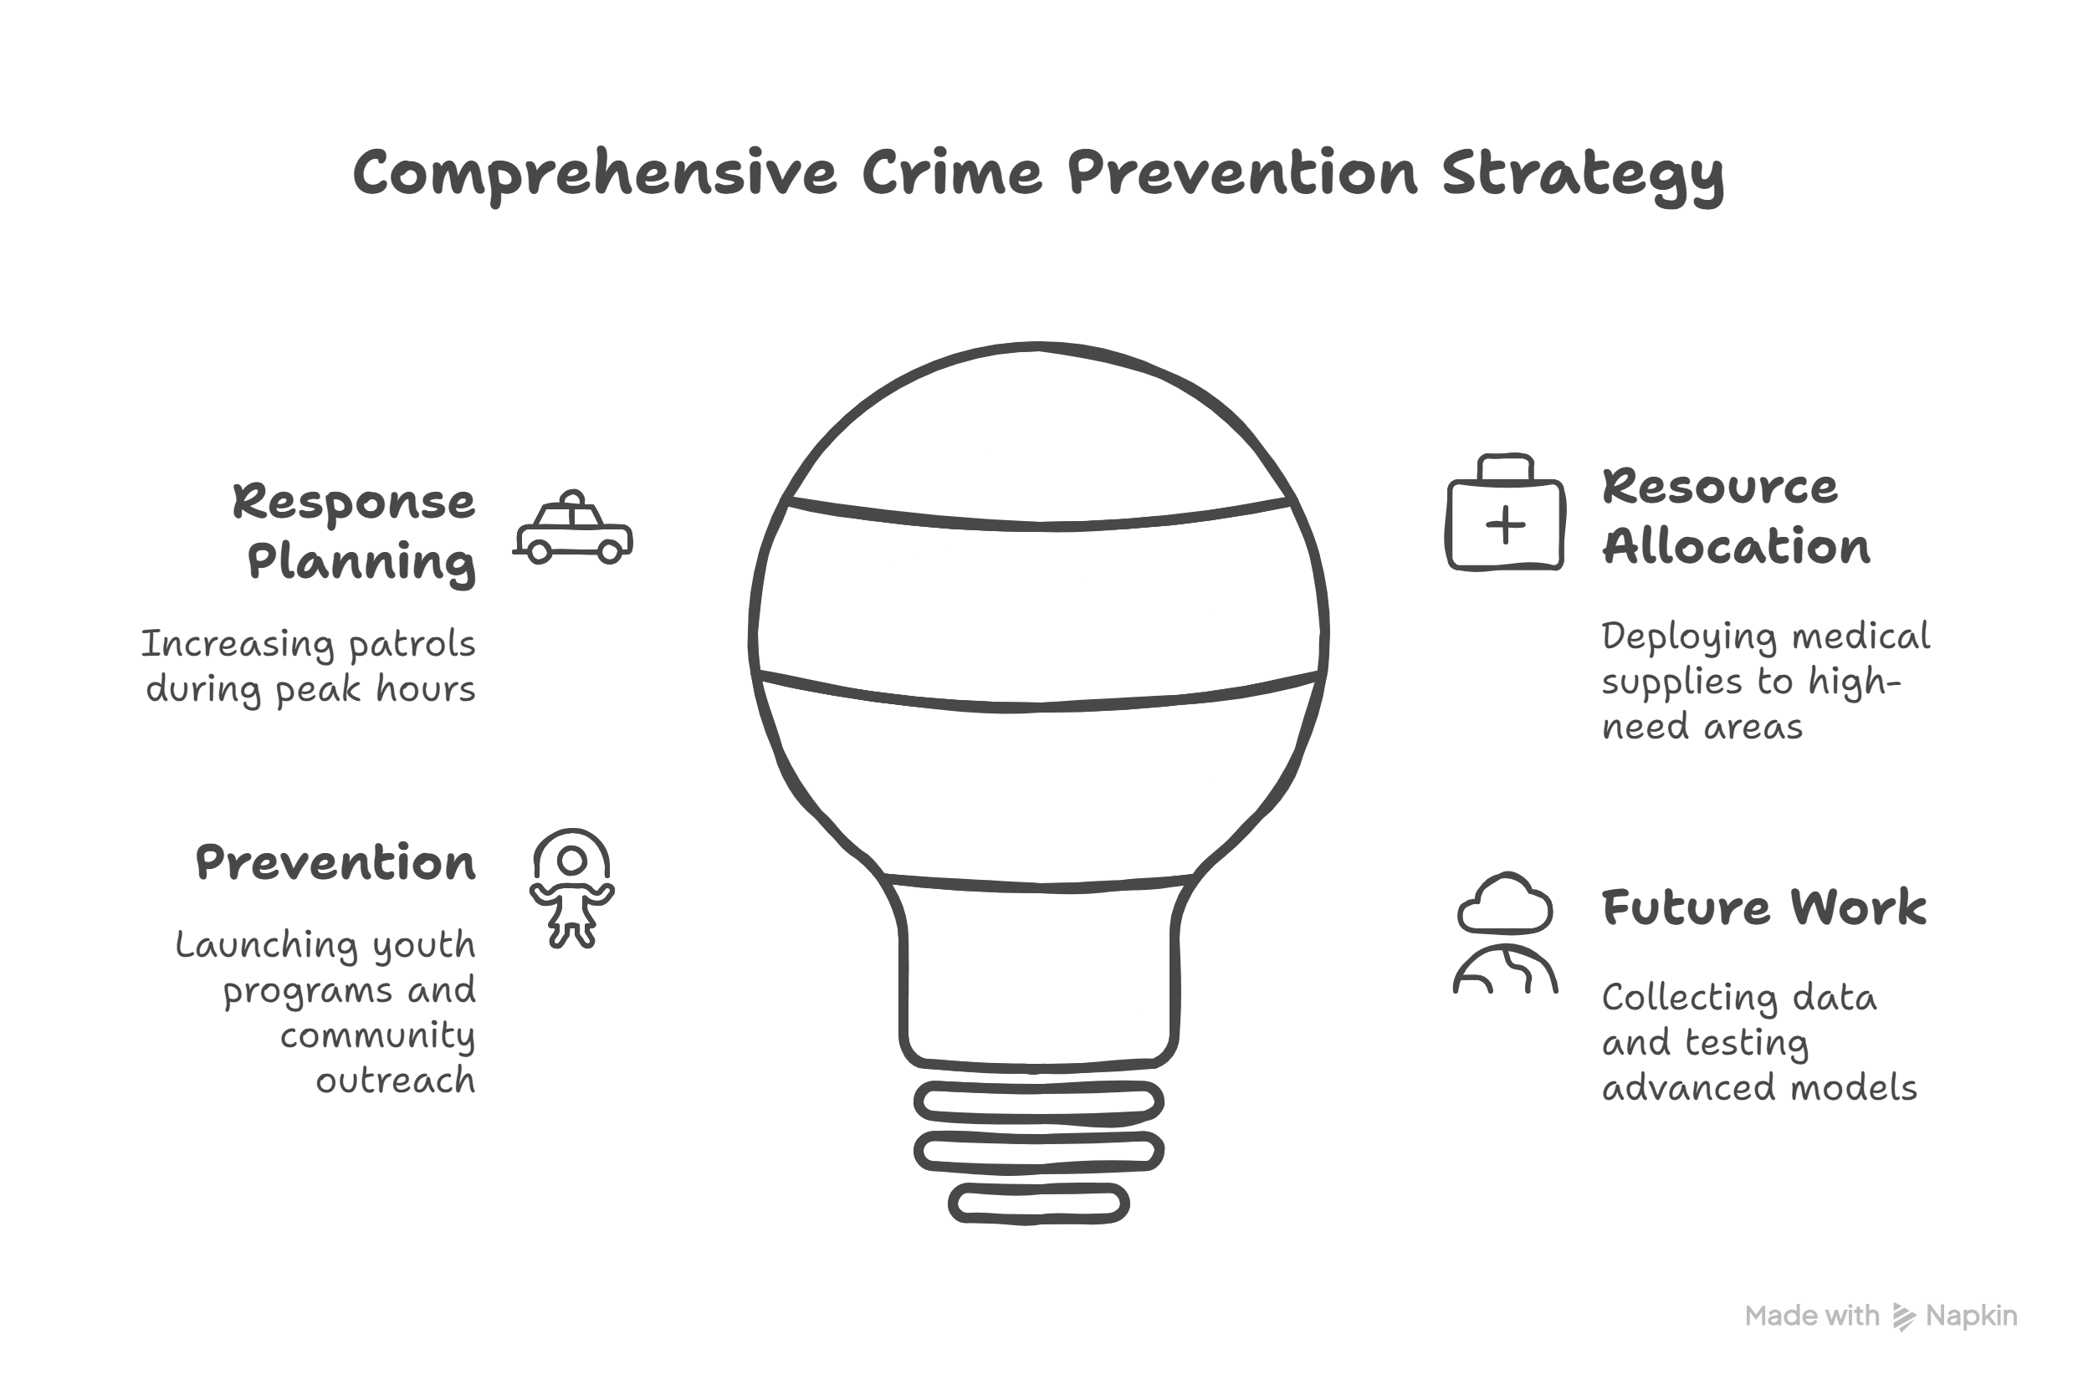
Actionable Recommendations
Response Planning:
Increase patrols in Bronx/Brooklyn from 22:00–02:00, especially on weekends.
Resource Allocation:
Deploy medical supplies to precincts 47, 73, and housing areas.
Prevention:
Launch youth programs for 18–44-year-olds in high-risk boroughs.
Address apartment-based violence via community outreach.
Future Work:
Collect data on response times, weapon types.
Test advanced models.

Slide 12
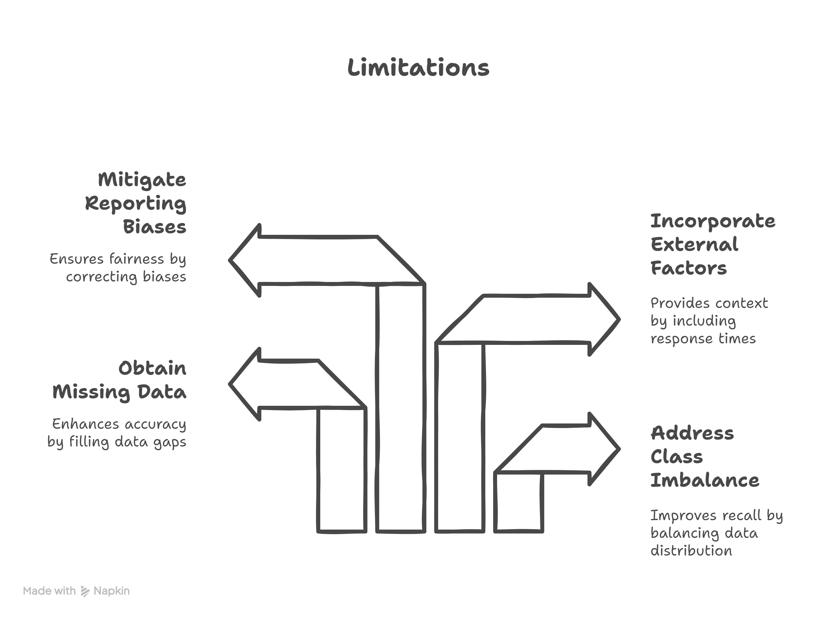
Limitations and Next Steps
Limitations:
Class imbalance limits fatal recall.
Missing perpetrator data reduces accuracy.
No external factors (e.g., response times).
Potential reporting biases.
Next Steps:
Enhance model with new data.
Deploy model via API for real-time use.
Collaborate with NYPD for validation.

Slide 13
Conclusion
Summary:
Built a 79%-accurate model to predict shooting fatalities.
Identified high-risk times (22:00–02:00), places (Bronx, precinct 47), and groups (18–44-year-olds).
Provided clear recommendations for law enforcement.
Impact: Supports safer communities through data-driven strategies.
Call to Action: Collaborate to implement and refine solutions.

